Slide 1
E-MEDICARE
PROJECT MEMBERS
1. A Sasank Reddy
2. Amit Kumar
3. Amitkumar Rajanal
4. Akshay X
5. Aditya Kumar
6. Akshay Kawade
7. Aarthi Ellappan
8. Abhilash M
9. Abburi Aruna
10. Akkamahadevi X

Slide 2
ABSTRACT
Increasing advancement in technology can turn up for the good of the society and here we are planning to bring change in health care and services.
The ultimate objective here is to design a E-Medicare Web Application that can perform medicine delivery with a much better secure system.
E-Medicare Health management system is based on the web application which is used by the customer’s to buy the online medicines to avoid the transport .
E-Health Care System project deals with Corporate Medicare Management. This project is very helpful to both Medicare staff as well as to the public. It is having mainly Administration and Client modules

Slide 3
INTRODUCTION
In Present scenario computer is an essential part for human life. It provides betterFacilities for storage and retrieval of information related to different areas of application. The medical stores are looking for the services that are accurate and reliable for providing services to the customers.
The detail of medicine which are available in medical store is easily managed and organized by using this system. The database for the customers can be managed by using this project. It is accessible either by an administrator the data can be retrieved easily.
In this Application we are going to provide online Medicine to the customer’s. Customer’s can find various types of medicine’s in this application the customer can buy the medicine at reasonable price. The User Interface is very user-friendly. The data are well protected for personal use and makes the data processing very fast.
The project E-Medicare includes registration of user/customer, storing their details into the system, and also computerized invoice.

Slide 4
PROPOSED SYSTEM
The proposed medical Booking Store system will completely Revolutionize the industry.
Searching of products, order placing, billing and product stock can be maintained by a single click.
The order placed can be easily tracked At any time. The payment of the order can also be done by credit cards.

Slide 5
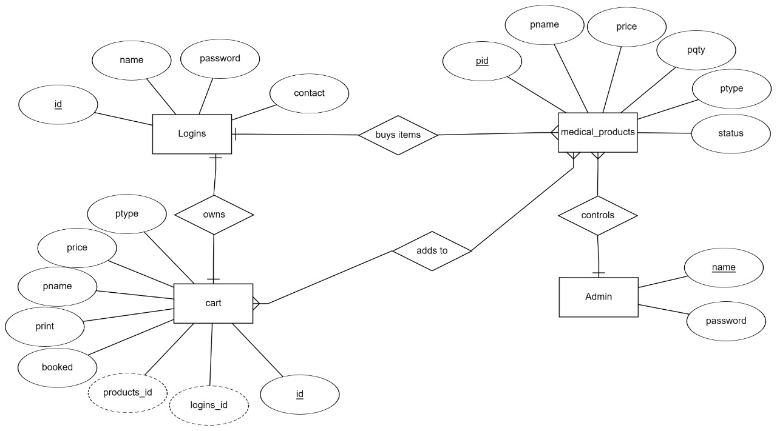
ER-DIAGRAM

Slide 6
TECHNOLOGY USED
Java : All the business logic has been written in Java
MySQL : MySQL database has been used as database for the project
Angular CLI : Command-line interface tool that we use to initialize.

Slide 7
ENVIRONMENT
The system will be developed on any Windows OS machine using J2EE, Hibernate and Spring.
Intel hardware machine (PC P4-2.26 GHz, 8 MB RAM, 80 GB HDD)
Server – Apache Tomcat 8
Database – My SQL
My SQL J Connector
Node Version 10
Angular CLI
JDK 1.8
Eclipse IDE or Spring Tool Suite

Slide 8
MODULES OF E-MEDICARE SYSTEM
Customer Module: Used for managing the Customer details.
Order Module: Used for managing the details of Order
Payment Module: Used for managing the details of Payment
Medicine Module: Used for managing the Medicine details
Login Module: Used for managing the login details
Users Module: Used for managing the users of the system.
Admin Module: Used for managing medicine details and user information.

Slide 9
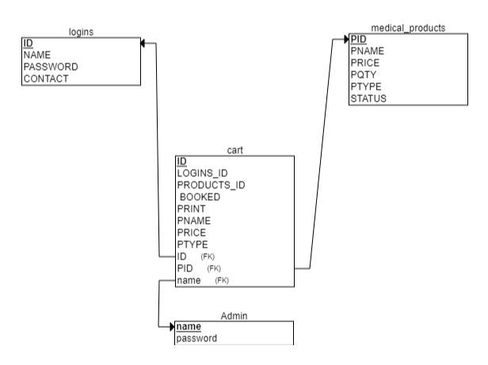
CLASS DIAGRAM

Slide 10
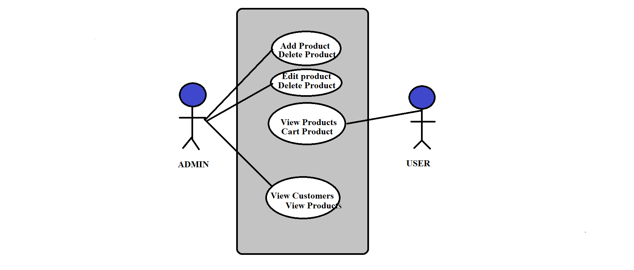
CASE DIAGRAM

Slide 11
ADVANTAGES
Cost efficient
Less time consuming
Time-saving: Online pharmacy saves your time and efforts, in just a few minutes you can head over the E-Medicare website and buy any prescription medicine as per your need.
It saves the time that you can spend in traveling to your local pharmacy shop and waiting in line for medicine.
Anytime anywhere: You can place your order anytime from anywhere as there is no issue of pharmacy closing down.
Easy Secured payments: Online pharmacy provides the facility of cashless payments either by credit or debit card, paytm or you can also pay by cash on delivery.

Slide 12
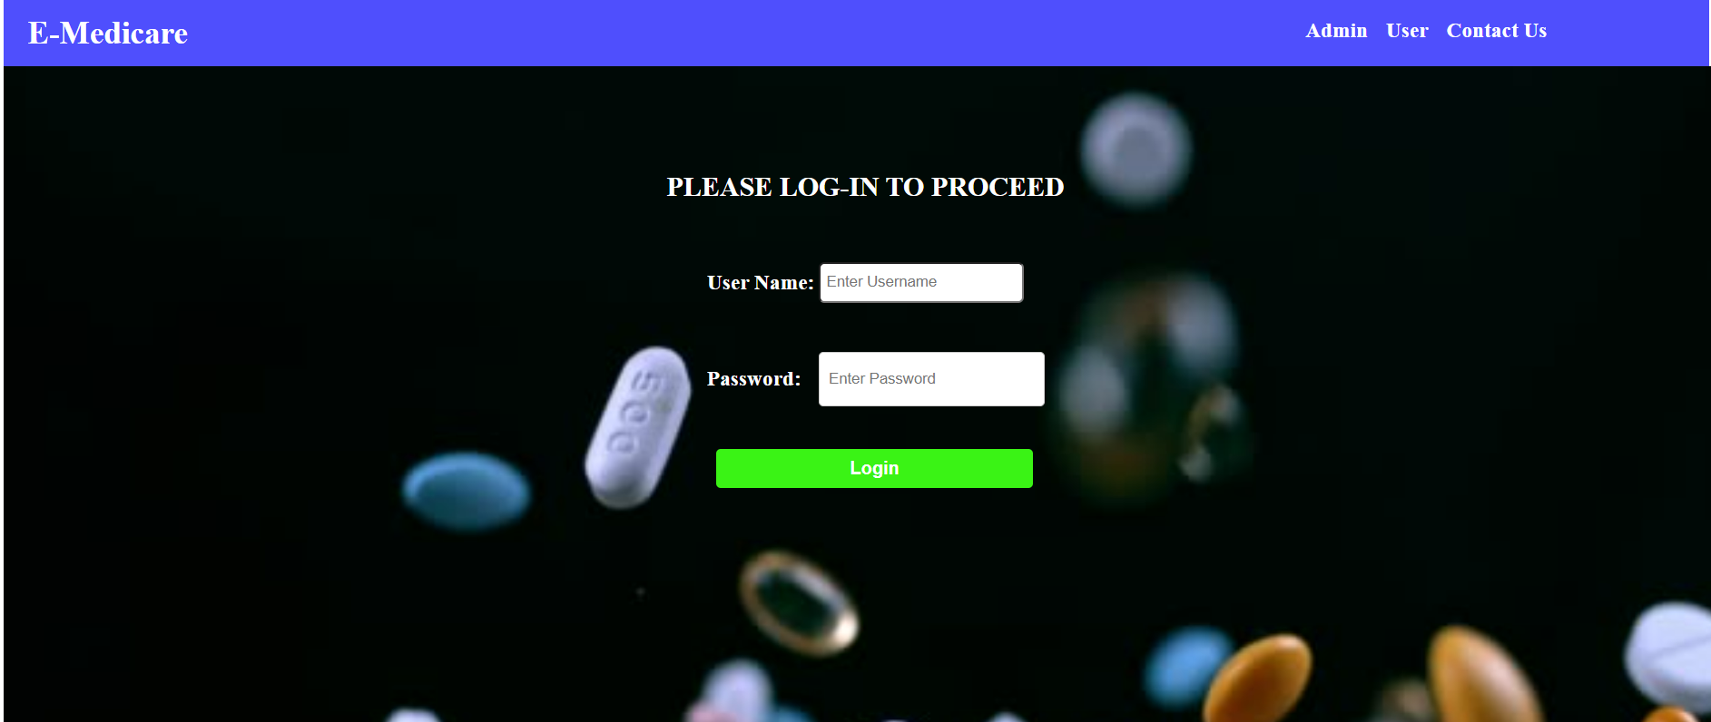
ADMIN PAGE

Slide 13
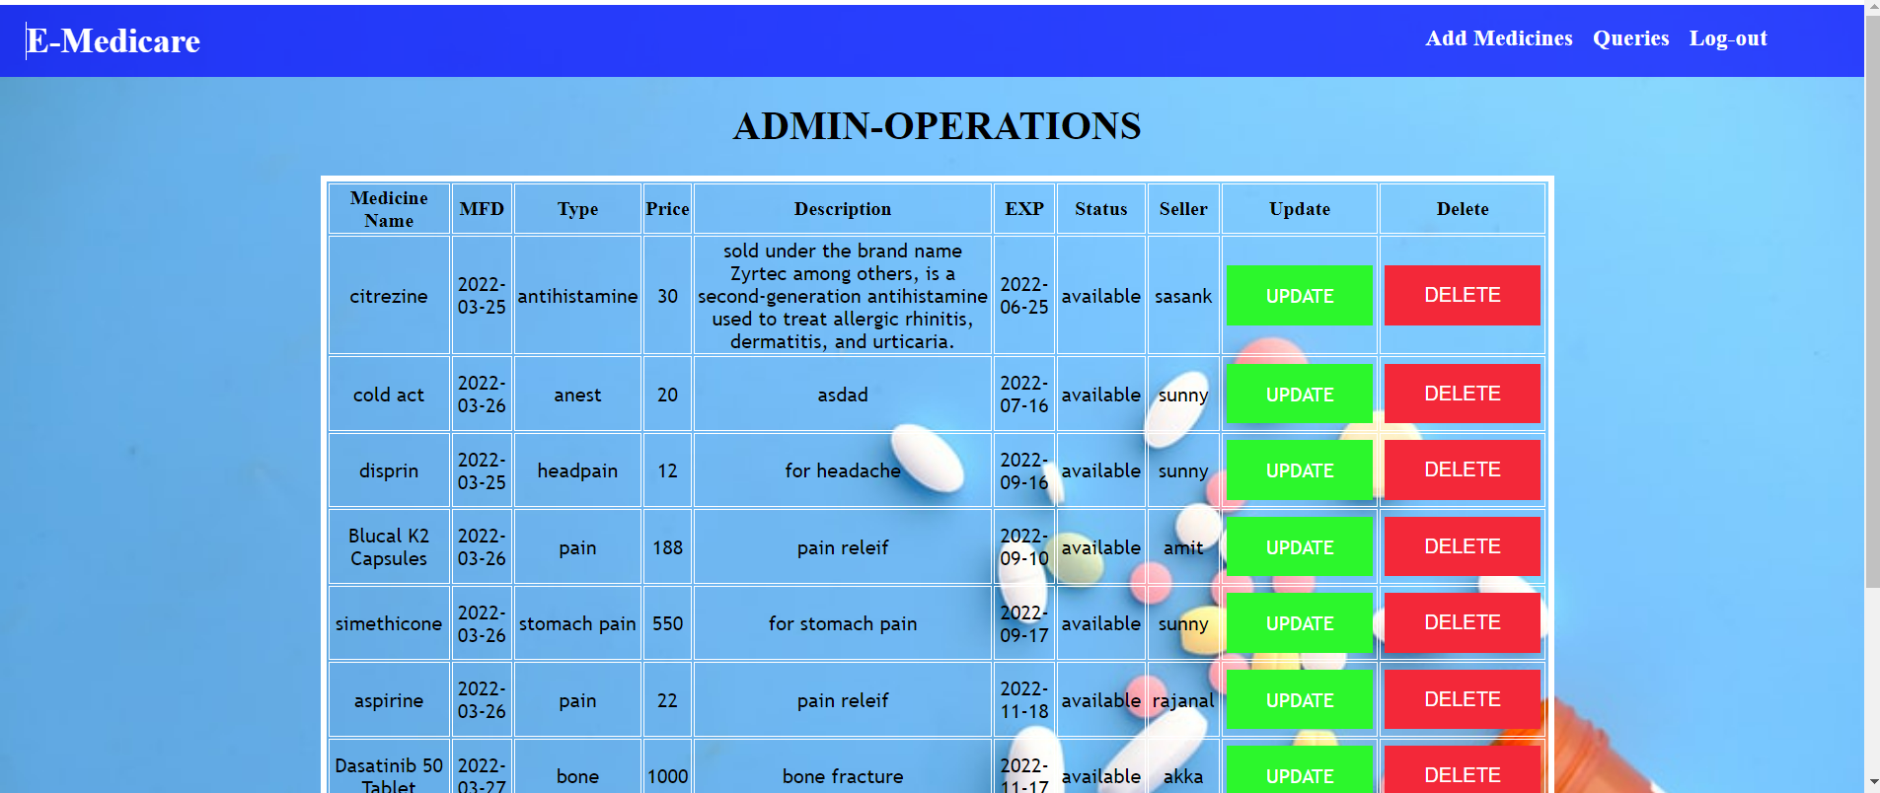

Slide 14
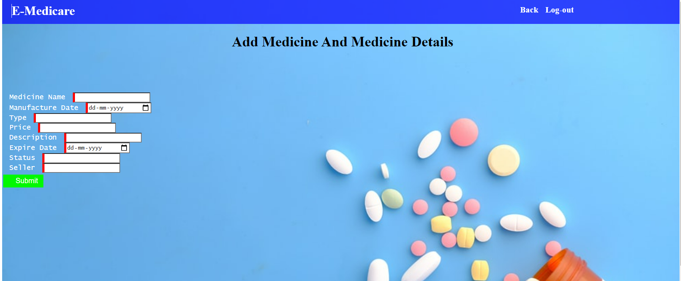
ADD MEDICINE DETAILS

Slide 15
VIEW ORDER LIST PAGE

Slide 16
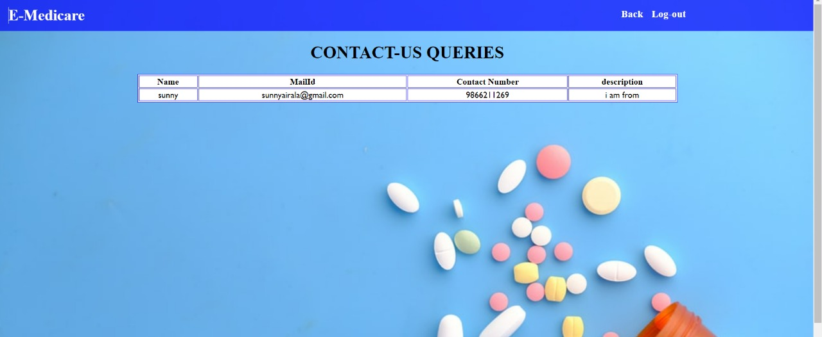
CONTACT US PAGE

Slide 17
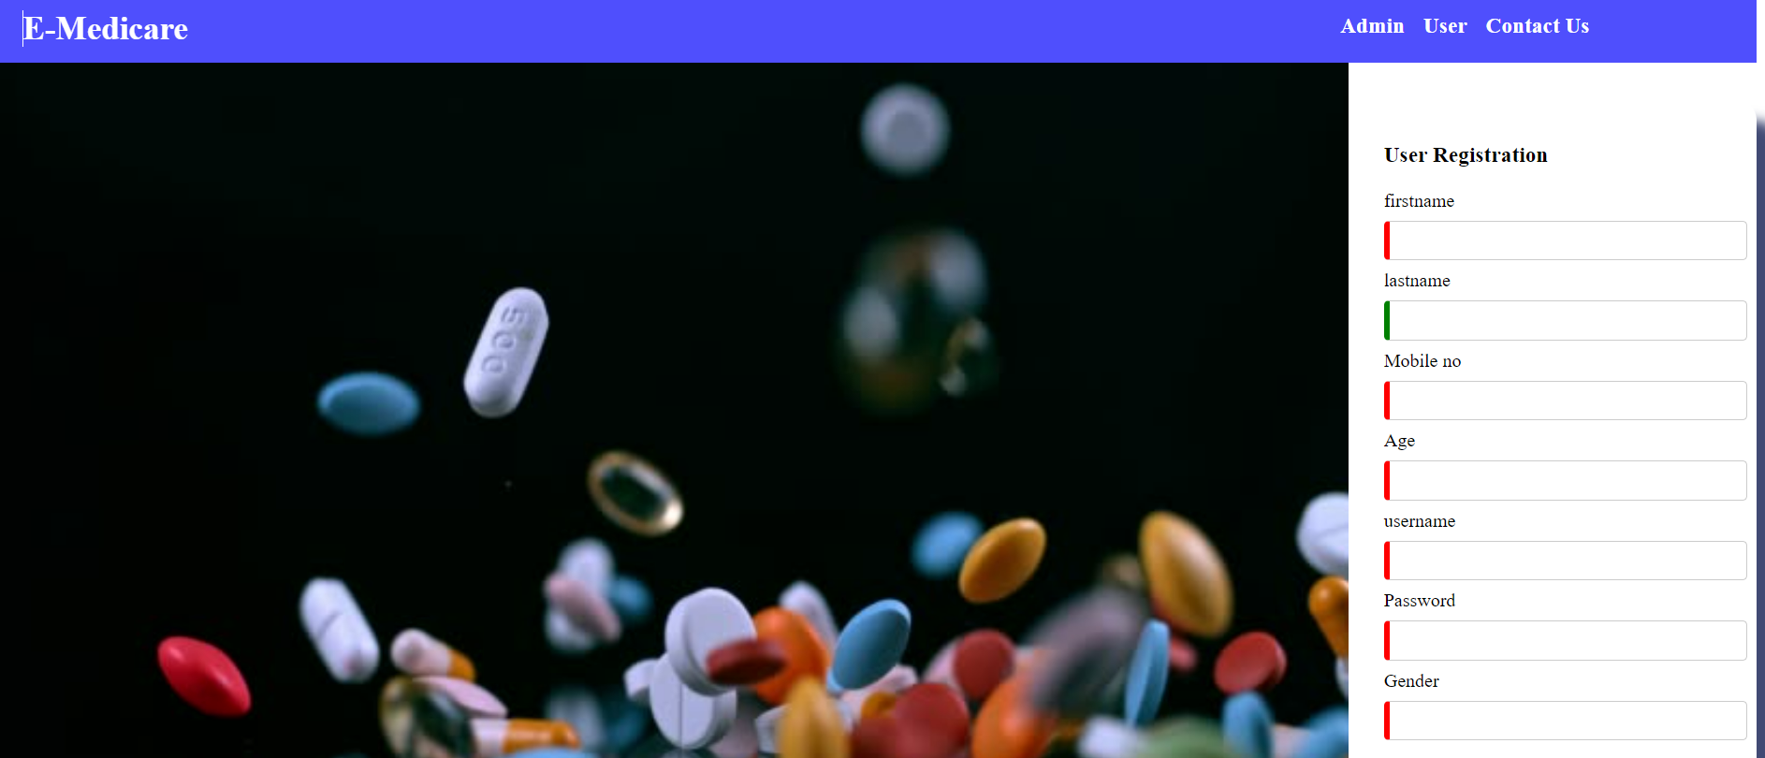
USER REGISTRATION PAGE

Slide 18
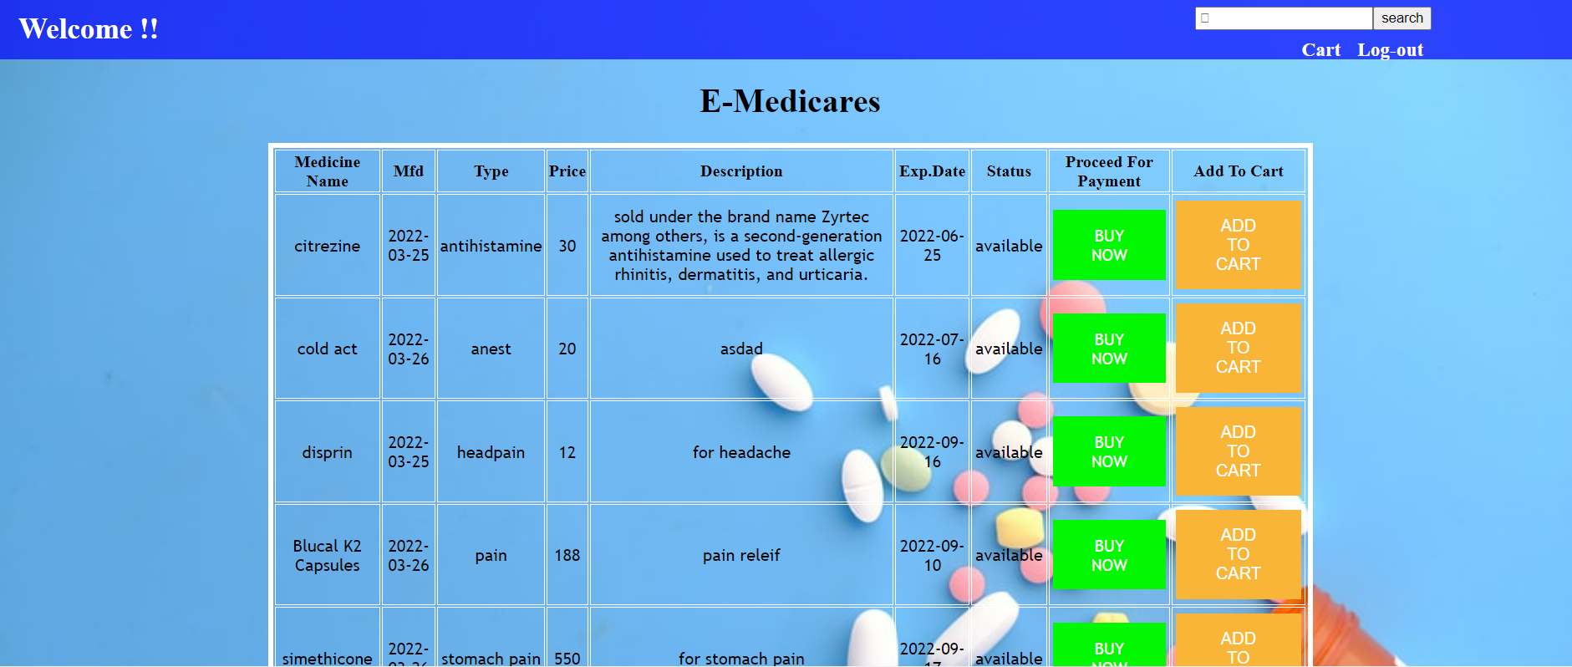
USER MEDICINE PAGE

Slide 19
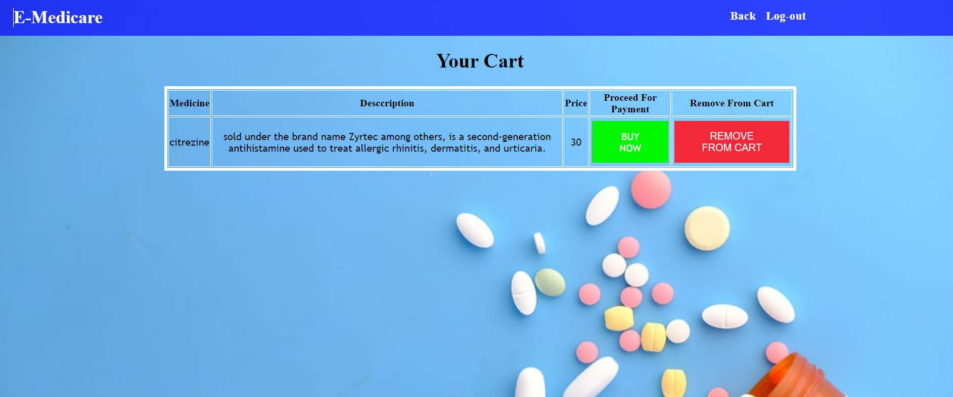
CART LIST PAGE

Slide 20
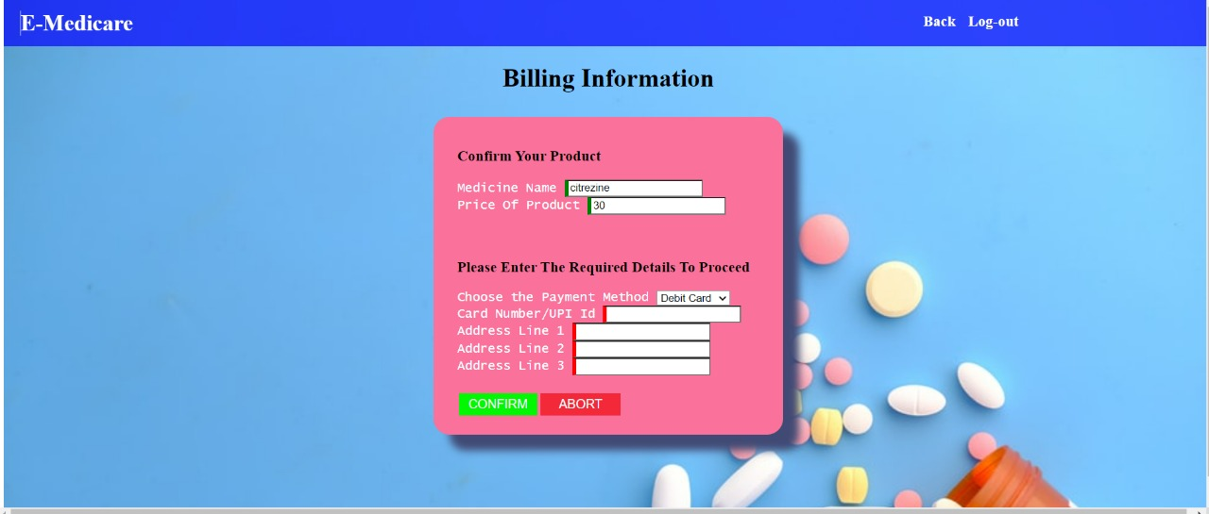
BILLING INFORMATION PAGE

Slide 21
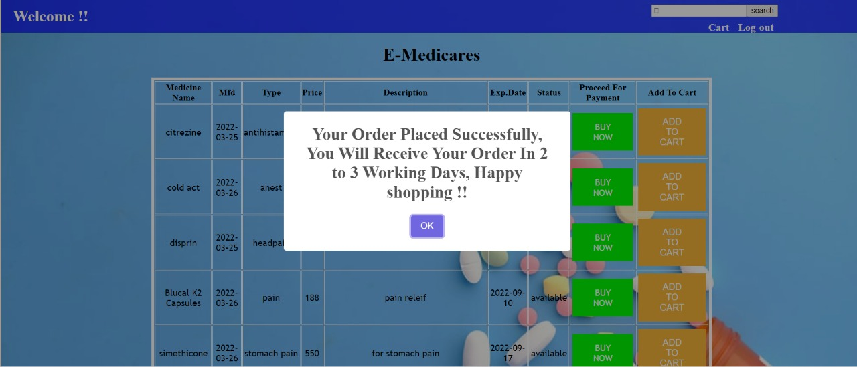

Slide 22
CONCLUSION
Our project is only a humble venture to satisfy the needs to manage their project work. Several user-friendly coding has also adopted. The objective of software planning is to provide a frame work that enables the manger to make reasonable estimates made within a limited time frame at the beginning of the software project and should be updated regularly as the project progresses.

Slide 23
THANK YOU

